Slide 1
CMOS circuits and Logic families
Lecture
ECE213
Someet Singh (ECE)

Slide 2
INTRODUCTION
ICs are integrated using following integration techniques
SSI (upto 12)
MSI (12 to 99)
LSI (100 to 9999)
VLSI (10,000 to 99999)
ULSI (> 100,000)
Someet Singh (ECE)

Slide 3
INTRODUCTION
Logic Family: It is a group of compatible ICs with the same logic levels and the supply voltages for performing various logic functions
They have been fabricated using a specific circuit configuration.
They are the building block of logic circuits.
It is set of techniques used to implement logic within large scale ICs (LSI).
Someet Singh (ECE)

Slide 4
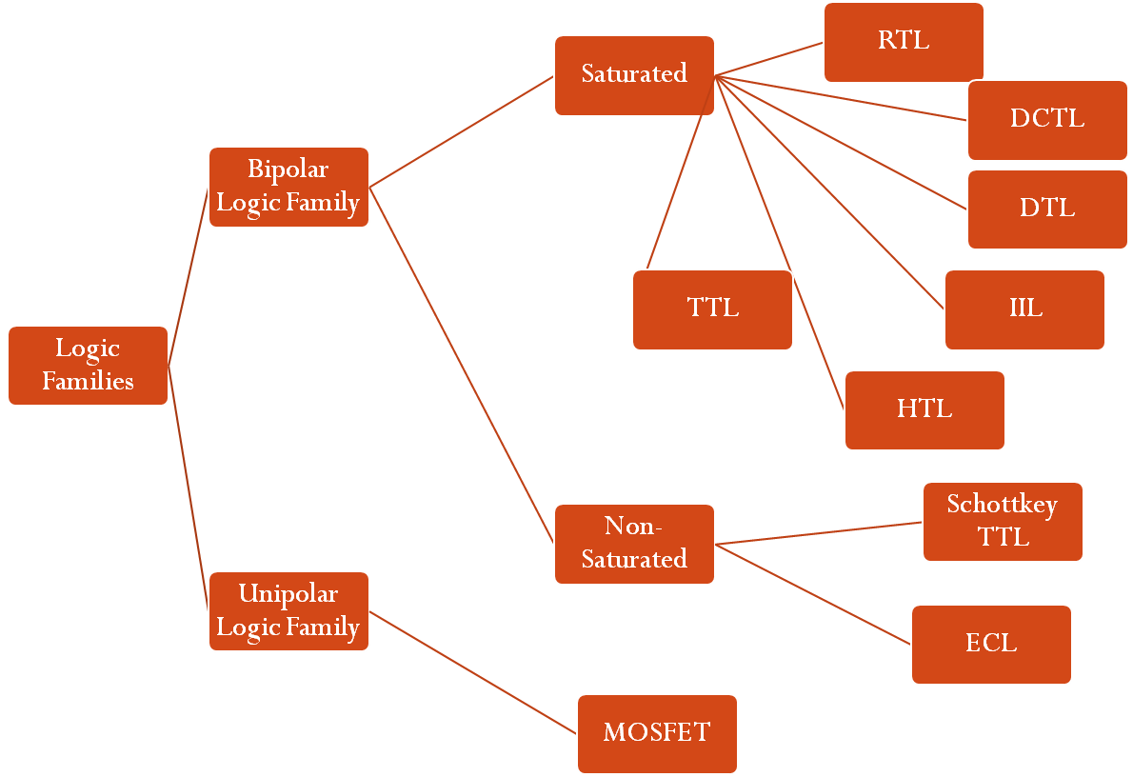
Types of logic families
Someet Singh (ECE)

Slide 5
BIPOLAR ICs
The main element of a bipolar ICs are Resistors, Diodes, Capacitors and Transistors.
They can be operated in two ways:
  Saturated
  Non-Saturated
Saturated Logic: The transistors in the IC are driven to saturation
Non-Saturated Logic: The transistors in the IC are not driven to saturation.
Someet Singh (ECE)

Slide 6
BIPOLAR ICs
Saturated Bipolar families are:
  Resistor-Transistor logic (RTL),
  Direct-Coupled transistor logic (DCTIL),
  Integrated-injection logic (IIL),
  Diode-transistor logic (DTL),
  High-Threshold logic (HTL) and
  Transistor-transistor logic (TTL)
Non-Saturated Bipolar families are:
  Schottkey TTL
  Emitter-Coupled logic (ECL)
Someet Singh (ECE)

Slide 7
UNIPOLAR LOGIC FAMILIES
MOS devices are unipolar devices and only MOSFETs are employed in MOS logic circuits.
These families are:
  PMOS (p-channel MOSFETs)
  NMOS (n-channel MOSFETs)
  CMOS (Both p- and n- channel MOSFETs are fabricated on same silicon chip)
Someet Singh (ECE)

Slide 8
Basic Characteristics of ICs
DC supply Voltage
Logic levels
Someet Singh (ECE)

Slide 9
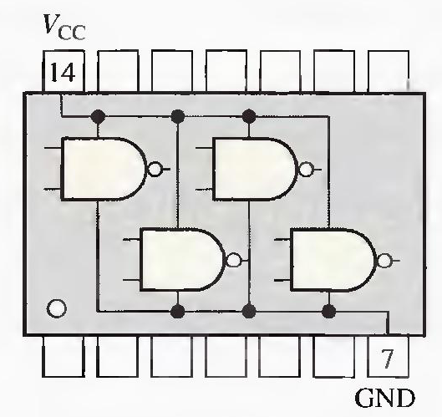
1) DC supply voltage
  CMOS and TTL are available in different supply voltage categories
  In each IC, Vcc pin is connected to positive supply and GND pin is connected to ground of supply.
Someet Singh (ECE)

Slide 10
2) LOGIC LEVELS
Four different kind of Logic level specifications are defined: VIL, VIH, VOL, VOH
  VIL, VIH : These are the input logic levels (Low & High)
  VOL, VOH : These are the output logic levels (Low & High)
CMOS is available in two different voltage levels: 3.3V and 5V
Someet Singh (ECE)

Slide 11
3) Noise Immunity
Noise is unwanted voltage that is induced in electrical circuits and can cause threat to proper operation of circuit.
Noise immunity is the ability to tolerate a certain amount of unwanted voltage fluctuations on its inputs without changing outputs
Someet Singh (ECE)

Slide 12
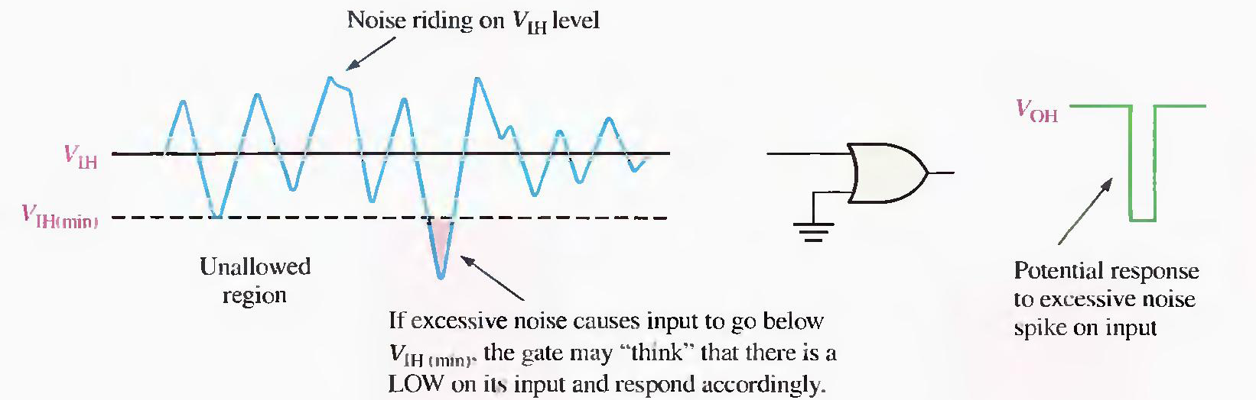
3) Noise Immunity
For example, If noise voltage causes the input of 5V CMOS gate to drop below 3.5V in HIGH state, then input lies in unallowed band and the operation becomes unpredictable
Someet Singh (ECE)

Slide 13
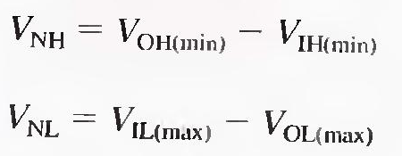
4) Noise Margin
A measure of circuits’ noise immunity is called Noise margin. It is expressed in volts.
  Two Noise margins are specified for logic circuits, High level Noise margin (VNH) and Low level Noise margin (VNL), expressed as:
Someet Singh (ECE)

Slide 14
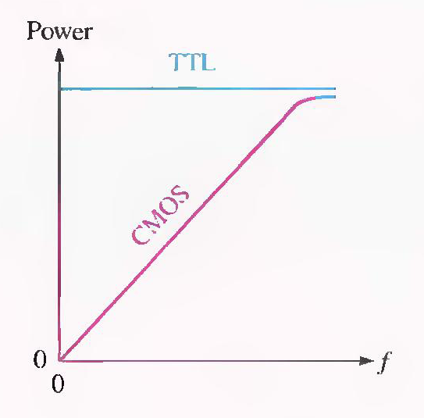
5) Power Dissipation
This is the amount of power dissipated in an IC.
It is Determined by the current Icc, that it draws from the Vcc supply, and is given by , Pd = Vcc X Icc.
Someet Singh (ECE)

Slide 15
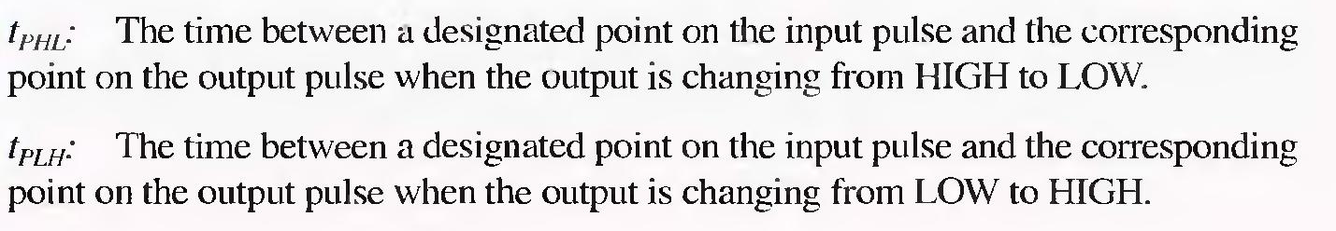
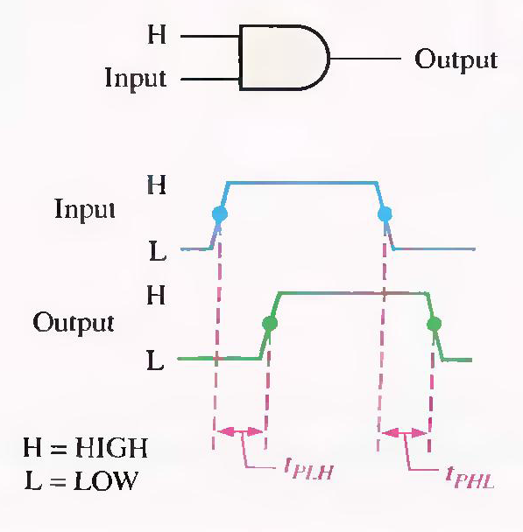
6) Propagation Delay
Someet Singh (ECE)

Slide 16
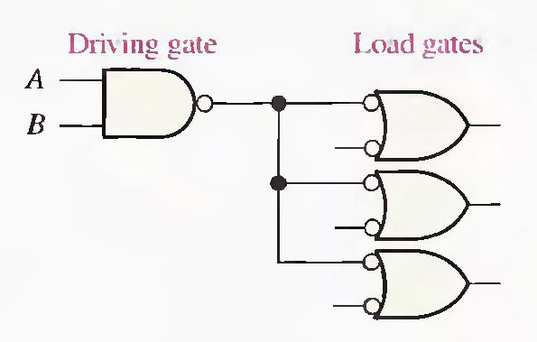
7) Fan out
The maximum number of inputs of the same series of an IC that can be connected to a gates’ output and still maintains the specified output voltage level.
Someet Singh (ECE)

Slide 17
CMOS CIRCUITS
Someet Singh (ECE)

Slide 18
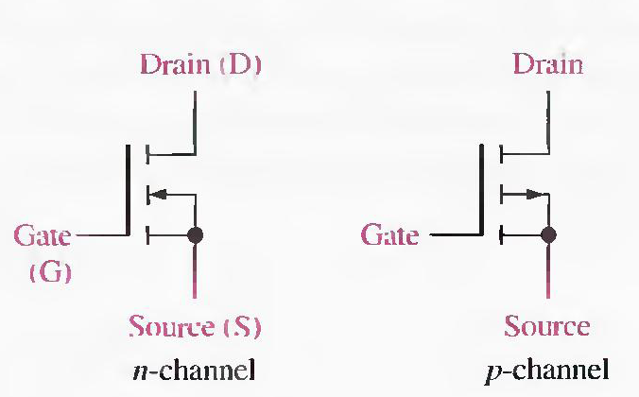
CMOS
CMOS stands for complementary metal oxide semiconductor FET.
  MOSFETs are the active switching elements in CMOS circuits
  MOSFETs are of two types: n-channel and p-channel
Someet Singh (ECE)

Slide 19
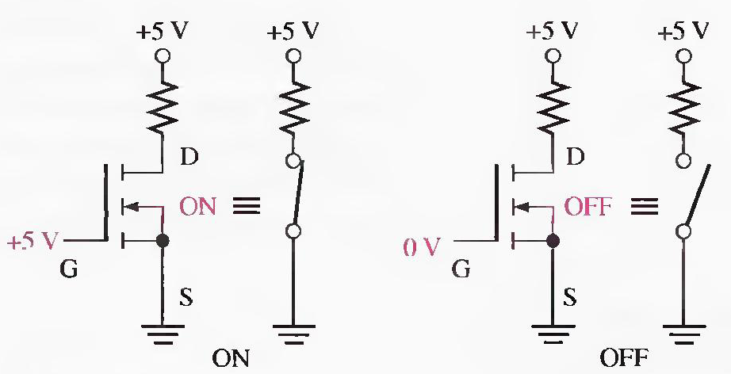
ON/OFF states of MOSFETs
N-channel switch
Someet Singh (ECE)

Slide 20
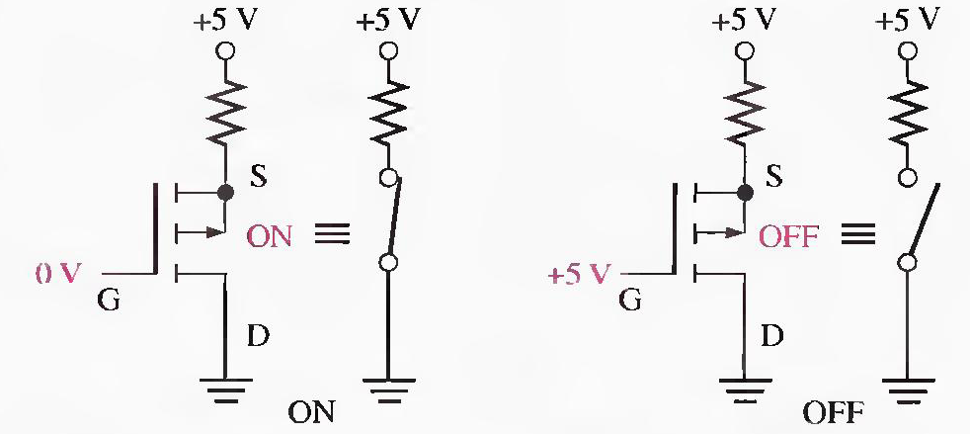
ON/OFF states of MOSFETs
P-channel switch
Someet Singh (ECE)

Slide 21
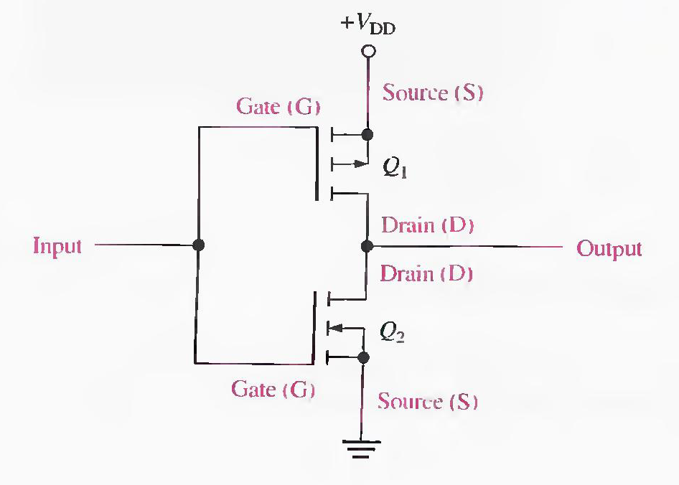
1) CMOS Inverter
It uses both P-channel and n-channel MOSFETs
Q1 = P-MOS
Q2 = N-MOS
Someet Singh (ECE)

Slide 22
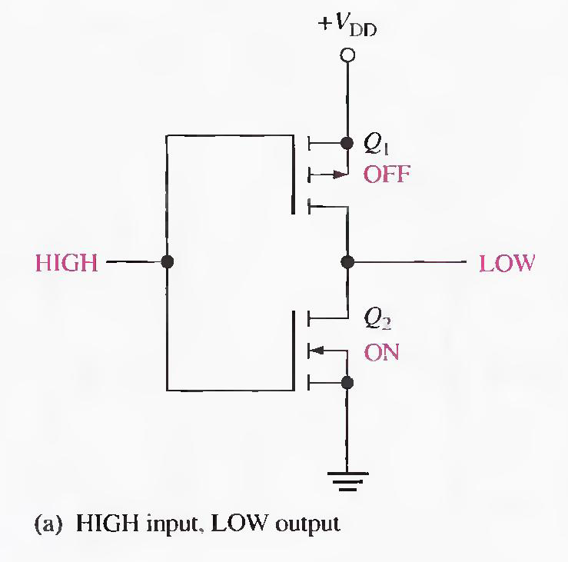
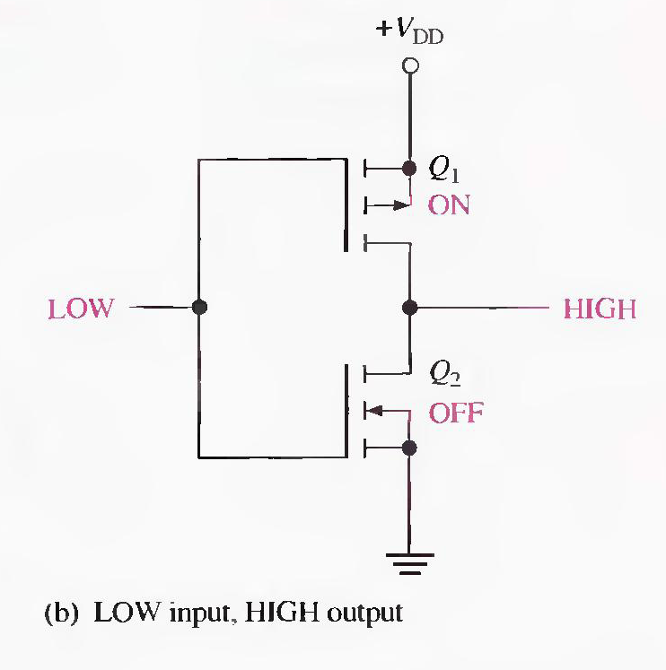
CMOS INVERTER CIRCUIT OPERATION
Someet Singh (ECE)

Slide 23
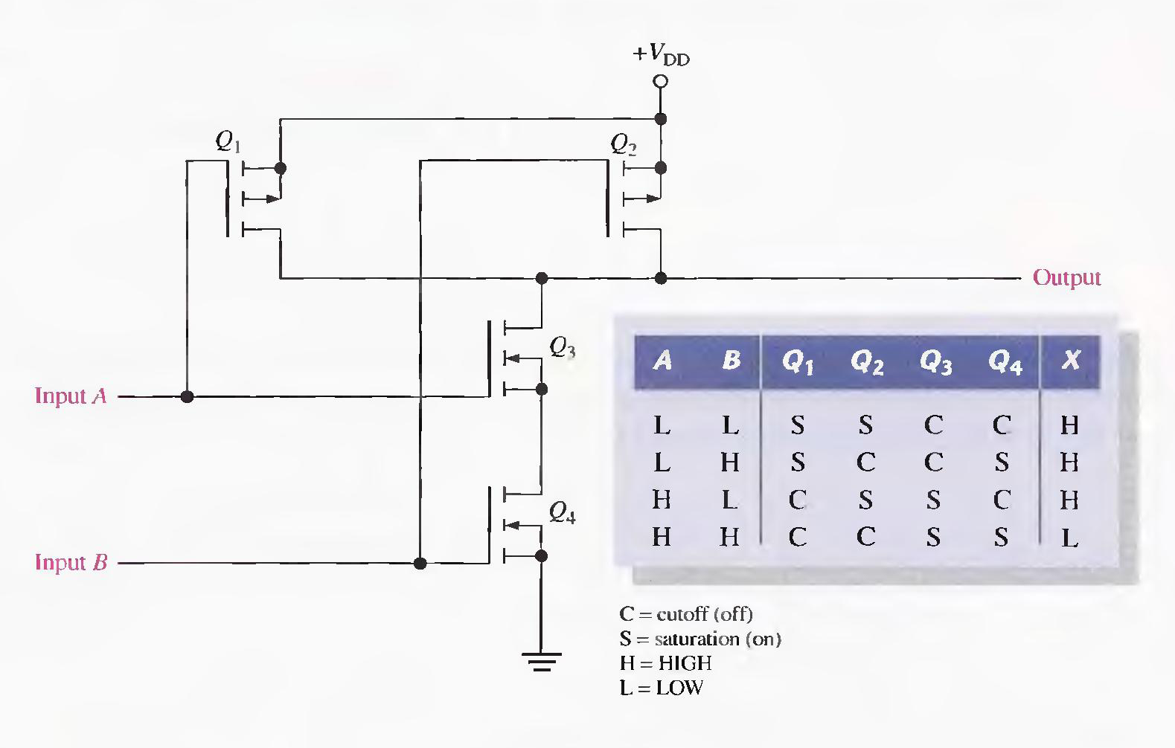
2) CMOS NAND GATE
Someet Singh (ECE)

Slide 24
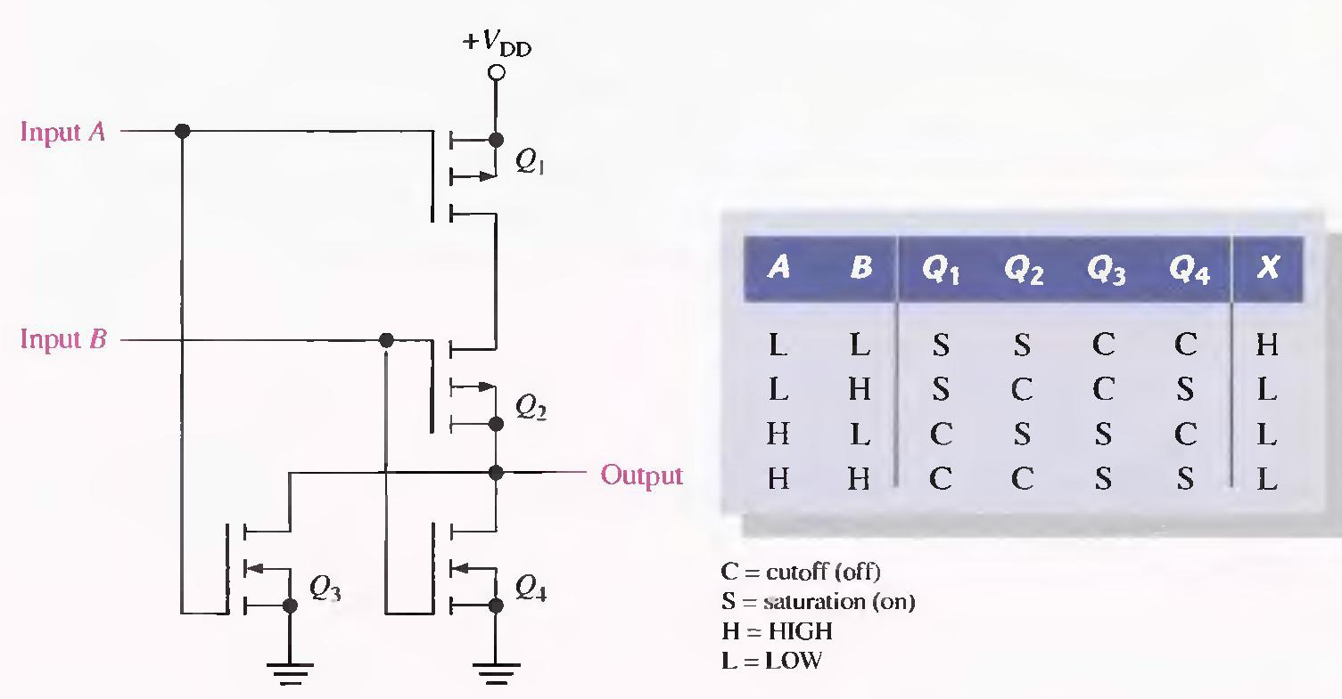
3) CMOS NOR GATE
Someet Singh (ECE)

Slide 25
RTL, DTL
Someet Singh (ECE)

Slide 26
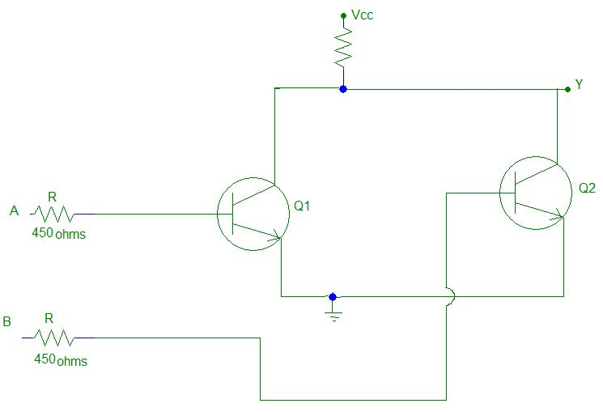
RTL gate circuit NPN
Someet Singh (ECE)

Slide 27
RTL operation
When A=B= 0:
  Both Q1 & Q2 are off, and current through Rc=0, So, drop across Rc = 0, Thus output voltage at Y becomes equal to Vcc i.e. 1
  Y = 1
When A=0, B=1:
  Q1 = off, Q2 = saturated
  Voutput = Vce2(sat) i.e. 0
  Y = 0
Someet Singh (ECE)

Slide 28
RTL operation
When A=1, B=0:
  Q1 = saturated, Q2 = off
  Voutput = Vce1(sat) i.e. 0
  Y = 0
When A = B = 1:
  Both Q1 & Q2 are in saturated
  Vout is at lower potential then required
  Y = 0
Someet Singh (ECE)

Slide 29
Advantages of RTL
Poor Noise Margin
Poor Fan out
Low speed
High power dissipation
Someet Singh (ECE)

Slide 30
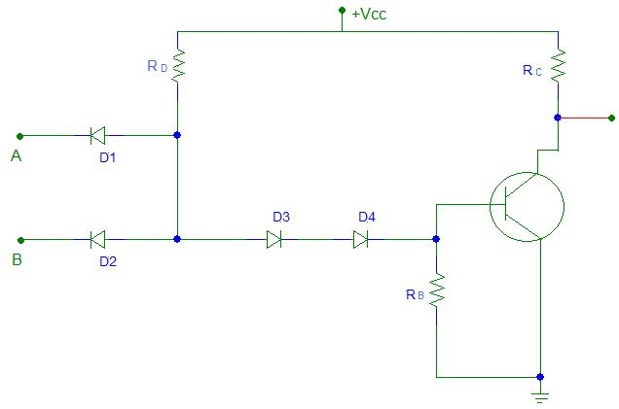
DTL GATE CIRCUIT
Someet Singh (ECE)

Slide 31
DTL OPERATION
A=B=0:
  D1 & D2 are Forward biased, Hence, Potential drop at M = 0.7V.
  But Q needs 2.1V to Forward bias D3 & D4, Therefore Q1 = cutoff & output Y = 1
Either A or B = 0:
  Again same procedure as above will follow
A=B=1:
  A = B= Vcc, Therefore D1 & D2 = Reverse Biased & do not conduct
  D3 & D4= Forward Biased & base current is supplied to Transistor via Rd,D3,D4. Thus, Q = saturated & Y=pulled down to low voltage & Y= 0
Someet Singh (ECE)

Slide 32
Advantages
Large Fan out
Good Noise Immunity
More Economical
Someet Singh (ECE)

